Slide 1

CASE STUDY
Sakila Movie Rental Store Data
By Rasireddy Theja

Slide 2
Introduction
Sakila is a well-established movie rental store offering a wide range of movies in both DVD and Blu-ray formats.
The management aims to analyze rental data to gain insights into popular movie genres and preferred actors.

Slide 3

CONTENT
TASK 1 :- Display the first names, last names, actor IDs, and the details of the last updated column.
TASK 2 :- Display the first names of actors along with the count of repeated first names.
TASK 3 :- Display the count of movies grouped by the ratings.
TASK 4 :- Calculate and display the average rental rates based on the movie ratings.
TASK 5A :-Display With replacement cost less the S9.
TASK 5B :-Display with replacement cost between S15 and 320.
TASK 5C :-Display with highest Replacement cost and lowest rental cost.
TASK 6 :-Number of movies with list of actors acted in it.
TASK 7 :-Display movie names stating with K and Q.
TASK 8 :-First name and Last name of actor in movie Agent True man.
TASK 9 :-Display titles in family categories.
TASK 10 :-Most frequent rented Movies.

Slide 4
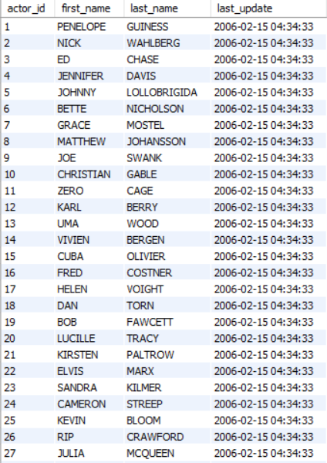
Task -1 details of the ACTORS LAST UPDATED
Query:
• select * from actor;
Conclusion:
There are total 200 actors in actor table.

Slide 5
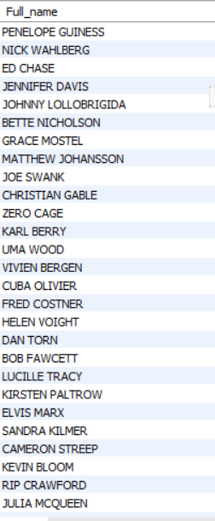
TASK-2A
Display the names of actors along with repeated full names
Query:
•select concat(first_name, ' ', last_name) as full_name
from actor;
Conclusion:
Full names of actors with repeated list displayed.

Slide 6
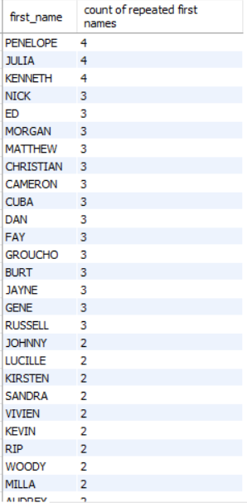
TASK-2B
Display the first names of actors along with the count of repeated first names
Query:
•SELECT first_name, COUNT(*) AS name_countFROM
actorGROUP BY first_nameHAVING COUNT(*) > 1;
Conclusion:
Firstnames names of actors with repeated list displayed.

Slide 7
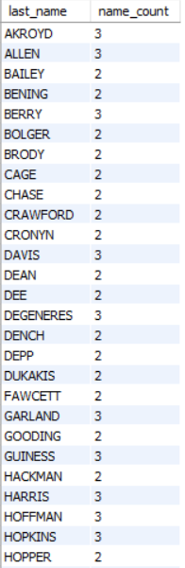
TASK-2C
Display the last names of actors along with the count of repeated last names
Query:
•select last_name, count(*) as name_countfrom actorgroup
by last_namehaving count(*) > 1;
Conclusion:
Last names of actors with repeated list displayed.

Slide 8
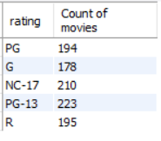
TASK-3
Display the count of movies grouped by the ratings
Query:
•select rating, count(*) as "count of movies"
from film
group by rating;
Conclusion:
Among all the ratings PG-13 has highest number
of movies.

Slide 9
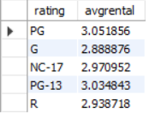
TASK-4
Calculate and display the average rental rates based on the movie ratings.
Query:
•select rating,avg(rental_rate) as 'avgrental’
from film
group by rating;
Conclusion:
PG has the highest average rental.

Slide 10

TASK-5A
Display the movie titles where the replacement cost is up to $9
Query:
•select title,replacement_cost from film
where replacement_cost =9
Conclusion:
There is no movies with the replacement cost up to $9

Slide 11
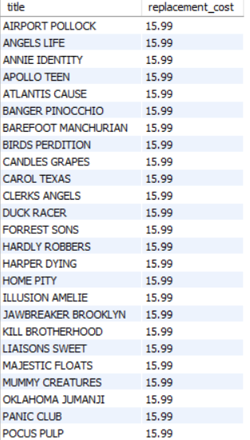
TASK-5B
Display the movie titles where the replacement cost is between $15 and $20.
Query:
• select title,replacement_costfrom filmwhere replacement_cost
between 15.00 and 20.00 order by replacement_cost asc;
Conclusion:
the movie titles where the replacement cost is between $15 and $20.

Slide 12
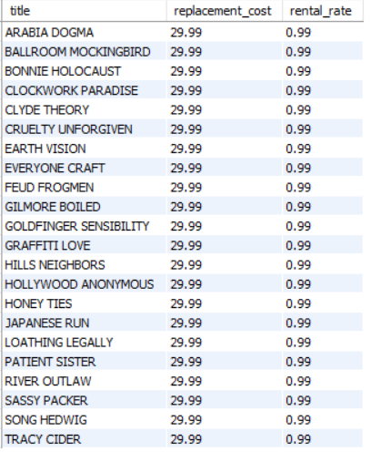
TASK-5C
Display the movie titles with the highest replacement cost and the lowest rental cost.
Query:
select title,replacement_cost,rental_ratefrom filmwhere
replacement_cost = ( select max(replacement_cost) from film)and
rental_rate = ( select min(rental_rate) from film);
Conclusion:
the movie titles with the highest replacement cost
and the lowest rental cost.

Slide 13
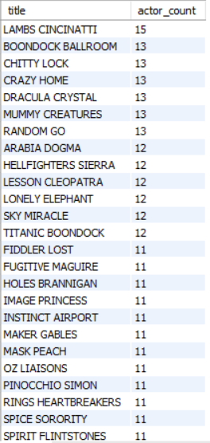
TASK-6
The management needs to know the list all the movies
along with the number of actors listed for each movie.
Query:
select film.title, count(*) as actor_countfrom filmjoin film_actor on
film.film_id = film_actor.film_idgroup by film.title
order by actor_count desc;
The list all the movies along with the number of actors.

Slide 14
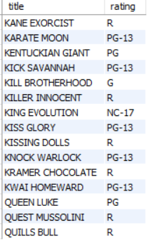
TASK-7
Display the movie titles stalling with the letters K and Q.
Query:
select title,ratingfrom filmwhere title like
'k%' or title like 'q%'order by title;
Conclusion:
Presented near by is a compilation of 15 films that
commence with the letters K and q.

Slide 15
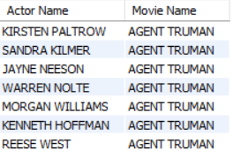
TASK-8
Display the first names and last names of all actors who are a part of this movie.
Query:
SELECTCONCAT(first_name,' ',last_name)
AS 'Actor Name',title AS 'Movie Name'FROMactorJOINfilm_actor USING
(actor_id)JOIN film USING (film_id)WHEREtitle = 'Agent Truman';
Conclusion:
The first names and last names of all actors
who are a part of this movie.

Slide 16
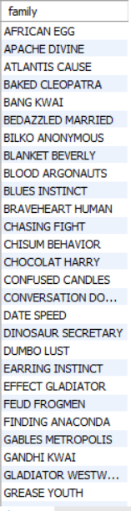
TASK-9
Identify & display the names of movies in the family category
Query:
select title as family from filmjoin film_category using(film_id)join
category using(category_id) where name = 'Family';
Conclusion:
The names of movies in the family category.

Slide 17
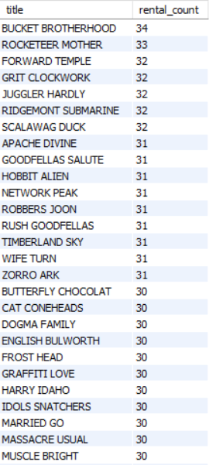
TASK-10
Display the names of the most frequently rented movies in descending order.
Query:
select film.title, count(rental.rental_id) as rental_countfrom filmjoin
inventory on film.film_id = inventory.film_idjoin rental on inventory.inventory
_id = rental.inventory_idgroup by film.titleorder by rental_count desc;
Conclusion:
'Bucket Brotherhood' was the most frequently rented movie has 34 rentals

Slide 18
THANK YOU
RASIRREDDY THEJA

